Slide 1
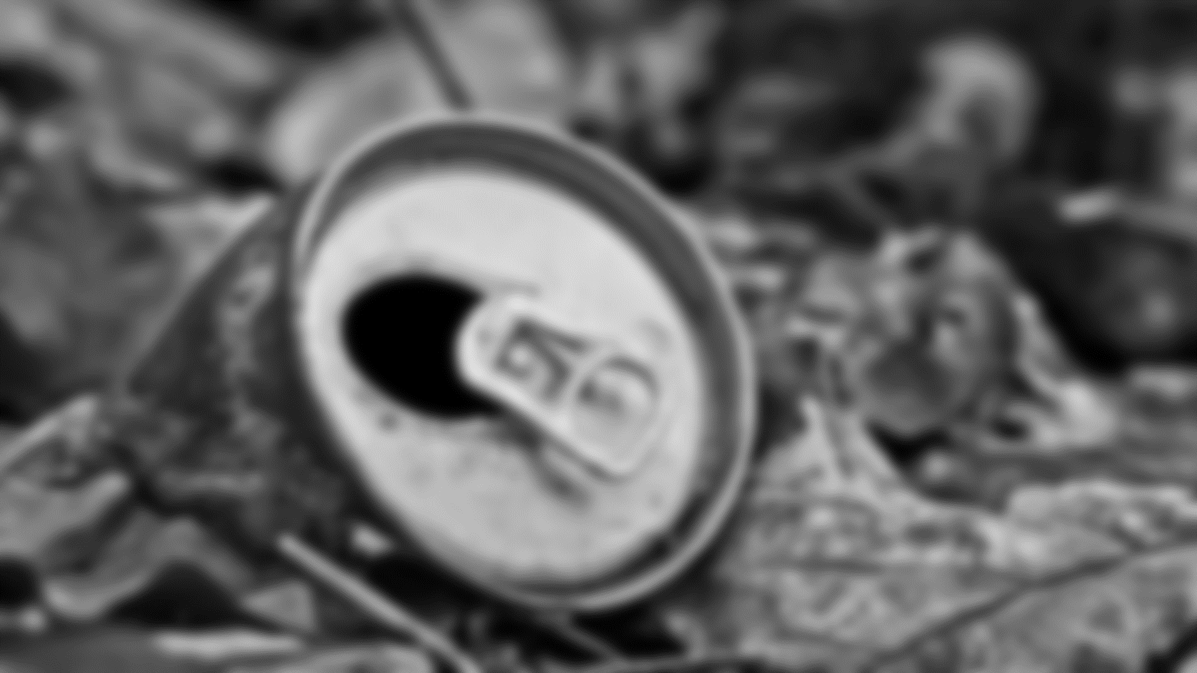
WASTES CLASSIFICATION
FOR REVERSE VENDING MACHINE
Riko Edhi Prasetya - 2101652510
Hans Michael - 2101665450

Slide 2








WASTES CLASSIFICATION

Slide 3
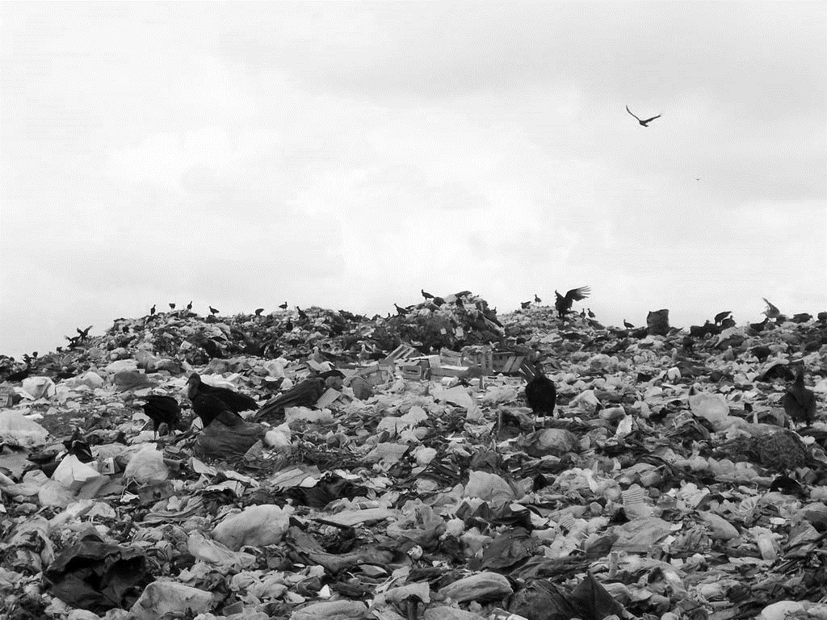

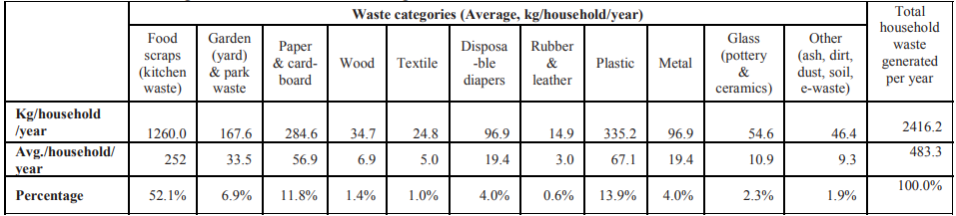
Background
“Jakarta is pumping out between 1900 and 2400 tons of plastic thrash everyday”
2013
WASTES DATA IN JAKARTA
Kaca(Glass)
Plastik(Plastic)
Kaleng(Metal)
Total
54.6 kg/hh/year
2.3%
335.2 kg/hh/year
13.9%
96.9 kg/hh/year
4.0%
2416.2 kg/household/year

Slide 4

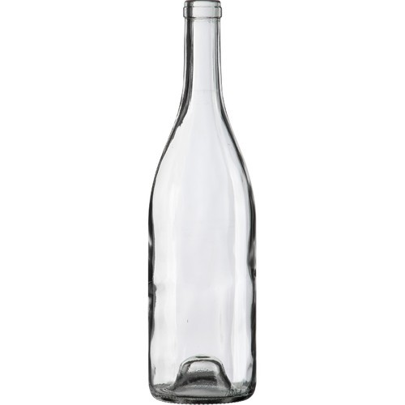
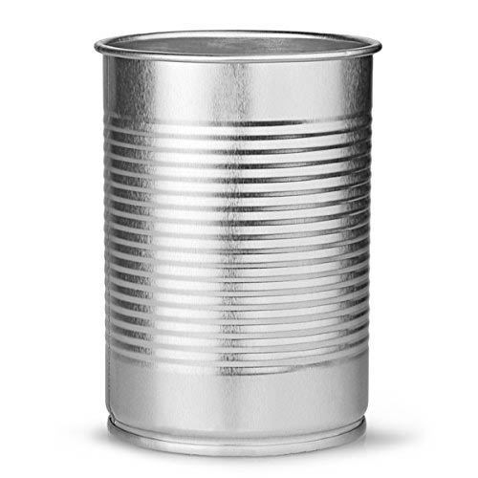
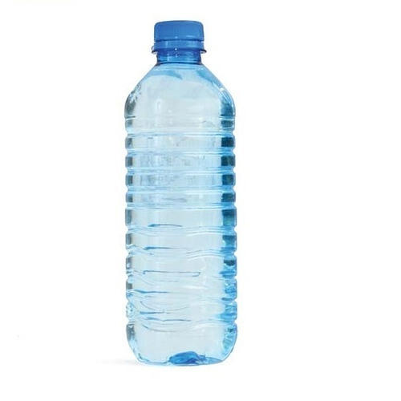
DATASET
419
376
344
Glass Bottle Images
Metal Can Images
Plastic Bottle Images

Slide 5

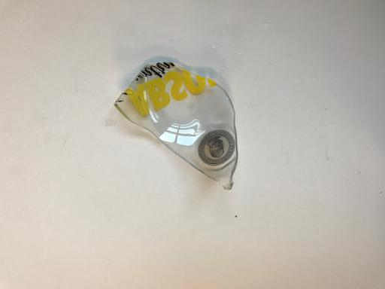
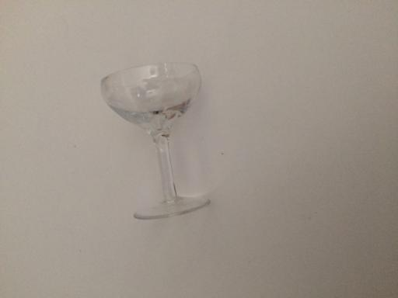
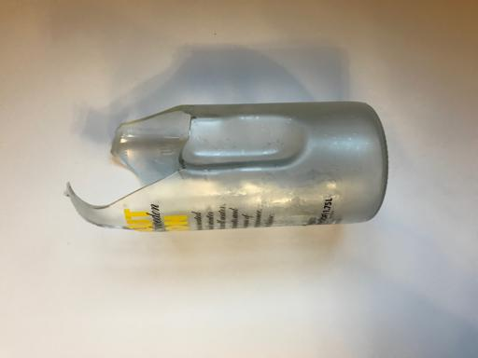
DATASETS
REMOVED
Glass Bottle Images

Slide 6

IMAGE CLASSIFICATION
TRAIN DATA
FEATURE EXTRACTION
CALCULATE HISTOGRAM
TRAIN CLASSIFIER
TEST DATA
FEATURE EXTRACTION
CALCULATE HISTOGRAM
CLASSIFIER
PREDICT

Slide 7

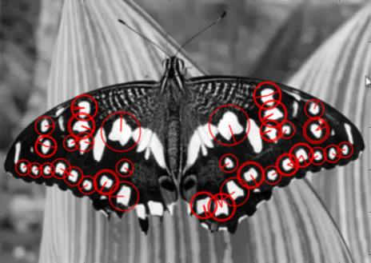
Features Extraction
Speeded Up Robust Features (SURF)
To find similarity between images with box filter
-Feature Extraction
-Feature Description

Slide 8
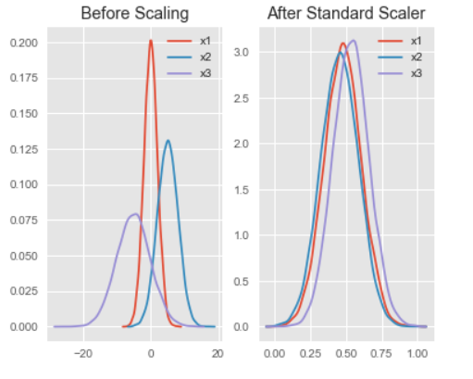
Histogram Normalization
Standard Scaler
Transform the data that its distribution will have a mean value 0 and standard deviation of 1. Then scaling to unit variance means dividing all the values by the standard deviation.

Slide 9
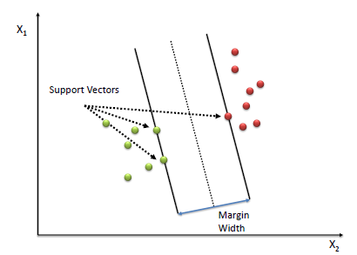
Classifier Model
Support Vector Machine
Supervised machine learning algorithm to solve classification or regression problems.
-Find the points closest to the line from both classes
-compute the distance between the line and support vectors
-maximize the margin to make the boundaries between two classes as wide as possible

Slide 10

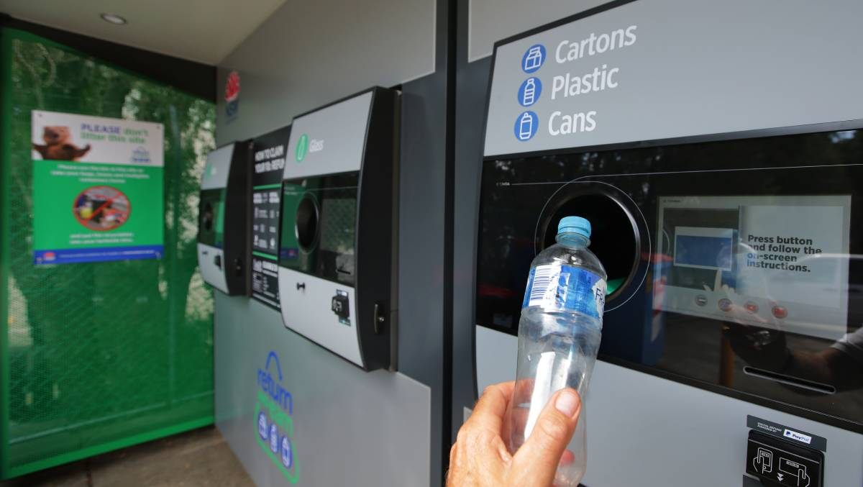
Reverse Vending Machine
Automatic Wastes Sorting
Using image classification to classify between wastes, then automatically sort the wastes to their own container.

Slide 11
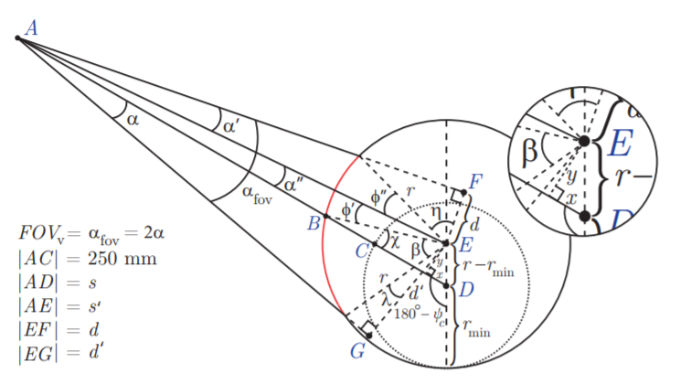
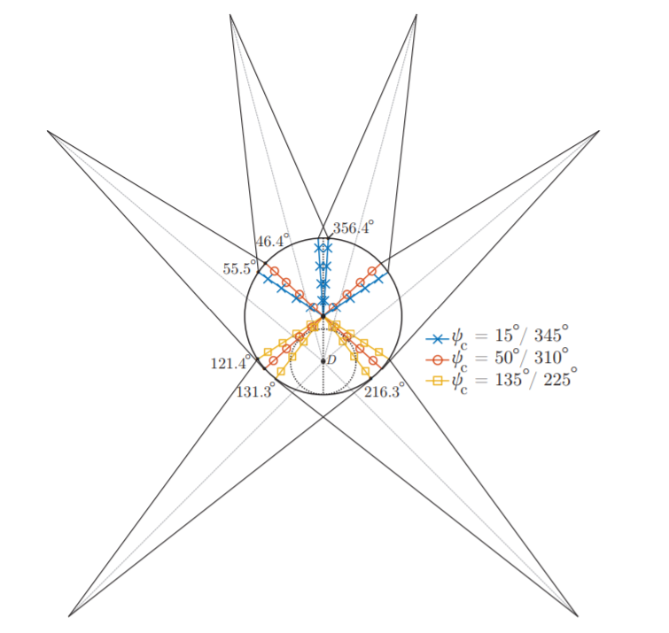
Camera Placement
Implementing image classification in the camera inside the reverse vending machine.
Using multiple camera to validate the object as the qualified object.

Slide 12

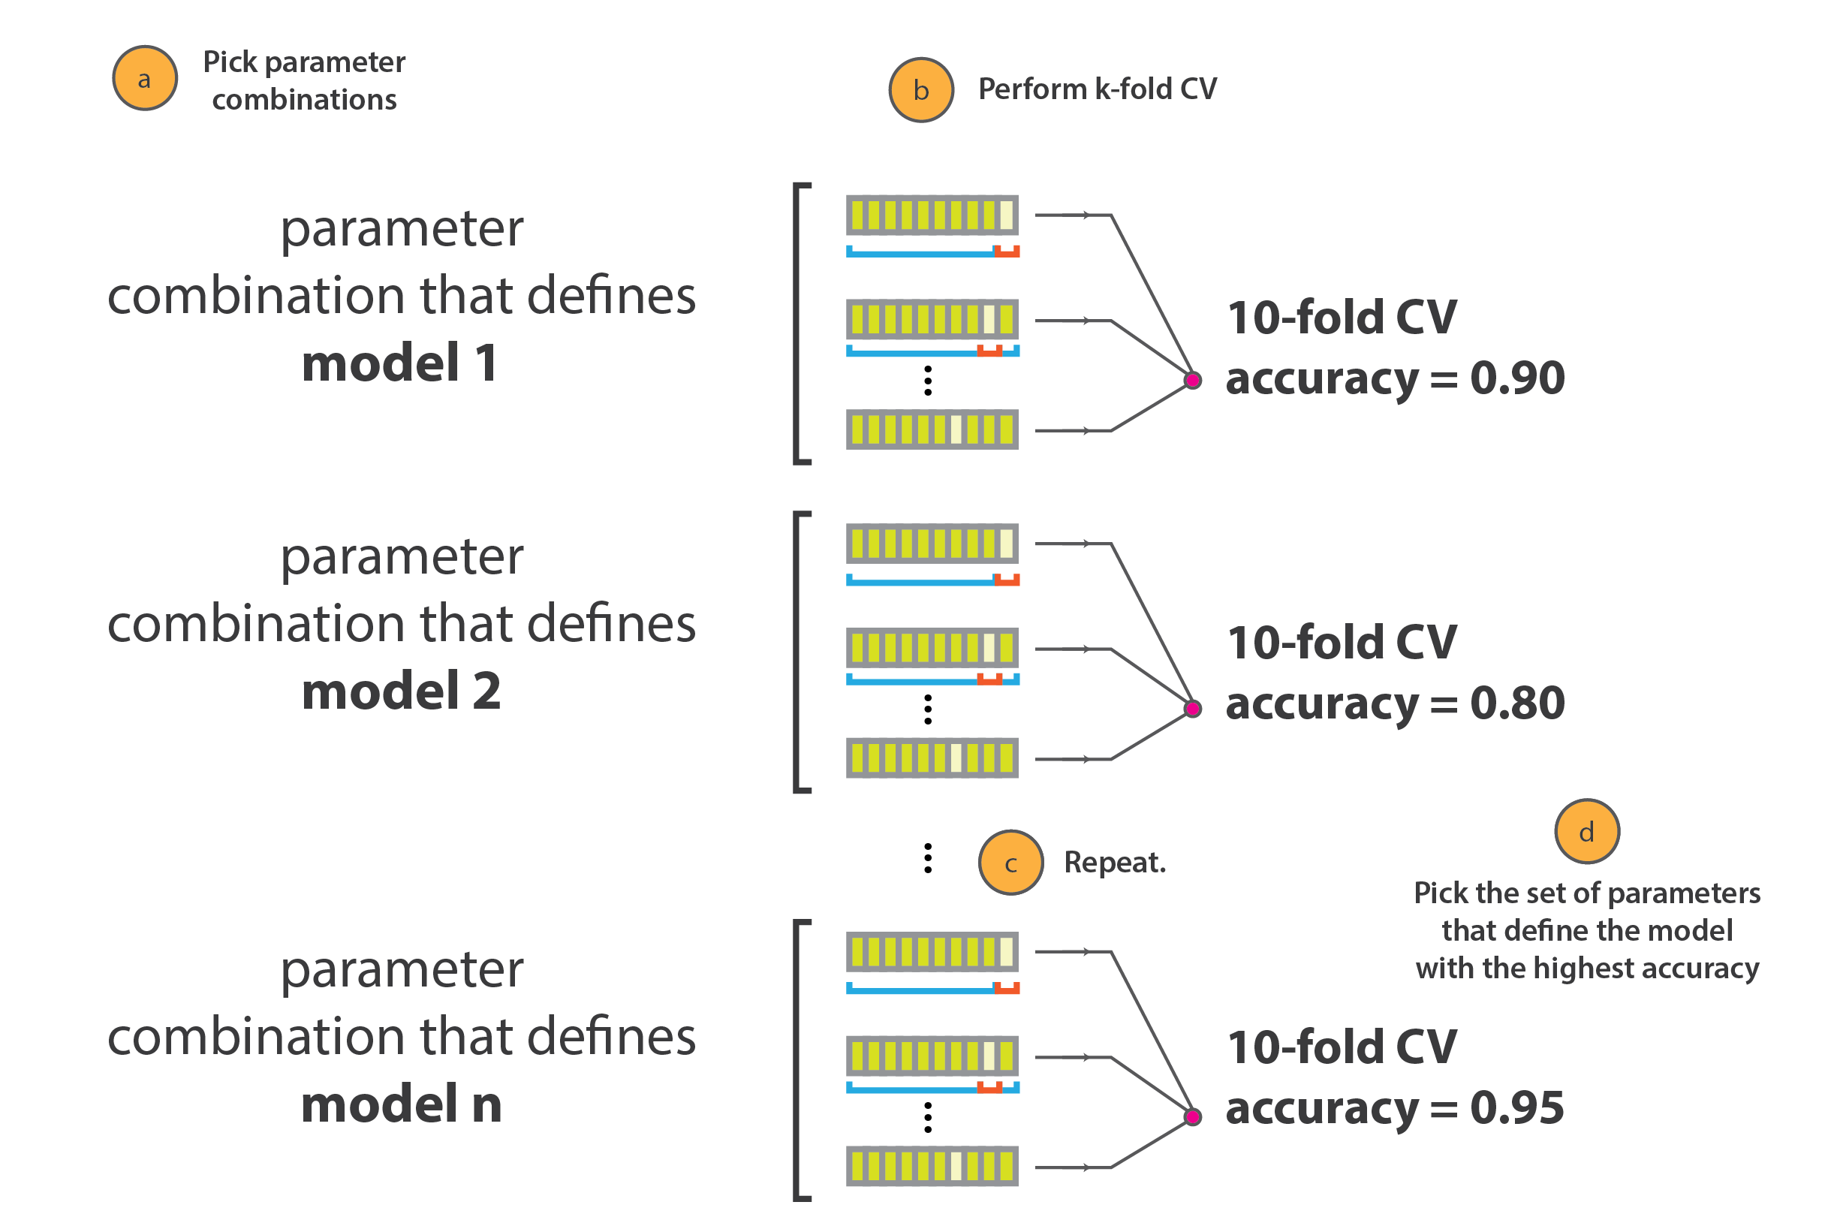
Parameter Tuning
Grid Search Cross Validation
Choosing a set of optimal hyperparameters for learning algorithm.
List of the parameters:
-C Value:
-Gamma Value
-Kernel
Lastly select the architecture which produces best result

Slide 13

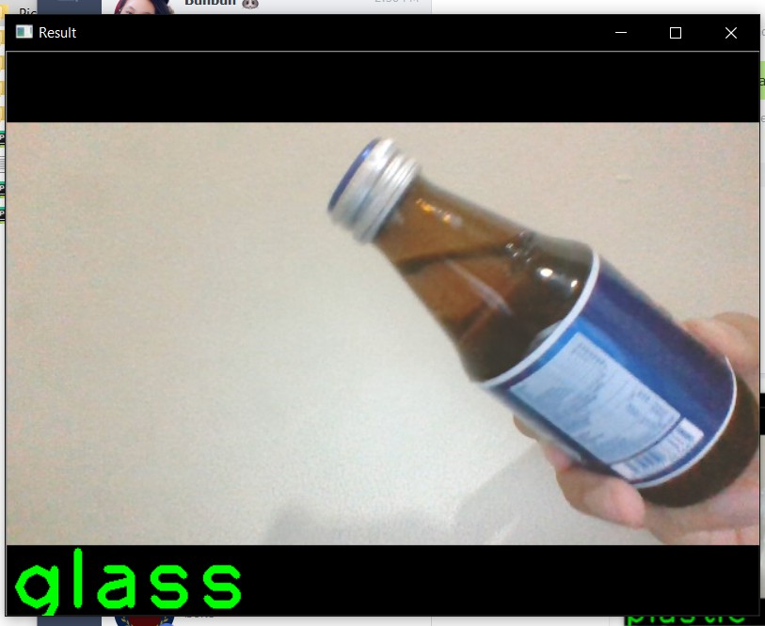
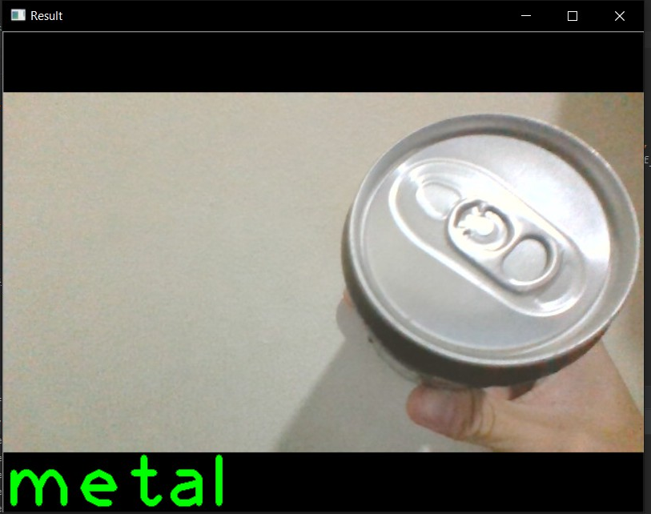
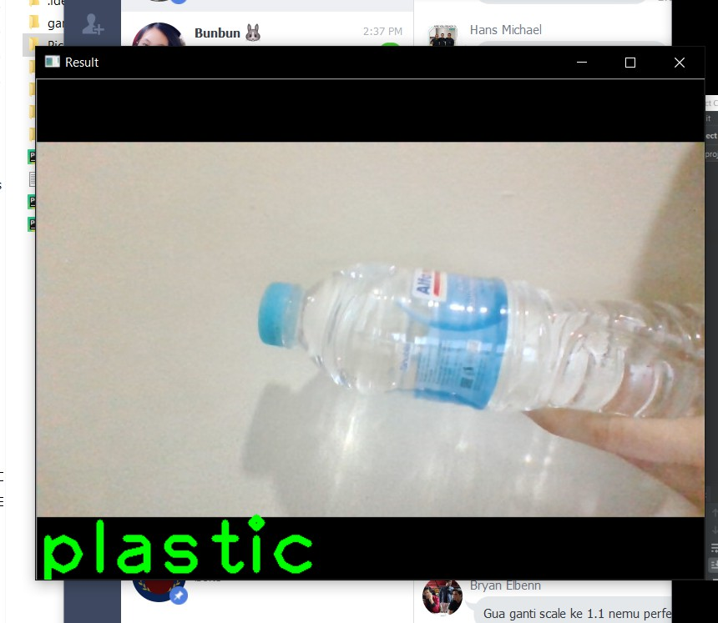
RESULT
Glass Bottle
Metal Can
Plastic Bottle

Slide 14

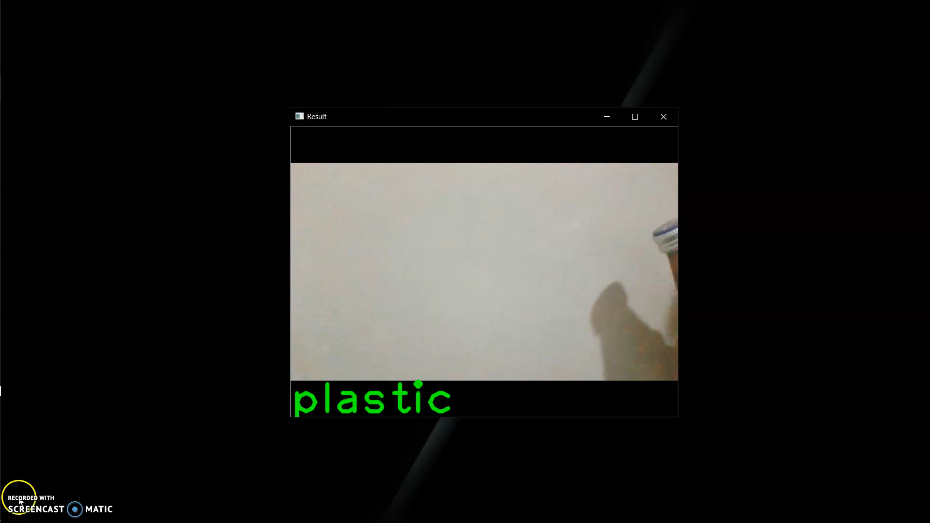
DEMO

Slide 15
REFERENCES
https://scikit-learn.org/stable/modules/generated/sklearn.svm.SVC.html
https://www.kaggle.com/ishivinal/model-tuning-grid-random-search-and-baysian-op
https://pdfs.semanticscholar.org/9cf4/3b88c08acac634665822cdf34dcad5c43e68.pdf
https://opencv-python-tutroals.readthedocs.io/en/latest/py_tutorials/py_feature2d/py_surf_intro/py_surf_intro.html
https://towardsdatascience.com/https-medium-com-pupalerushikesh-svm-f4b42800e989
http://benalexkeen.com/feature-scaling-with-scikit-learn/
https://scikit-learn.org/stable/auto_examples/applications/plot_face_recognition.html#sphx-glr-auto-examples-applications-plot-face-recognition-py
https://www.thejakartapost.com/news/2018/08/10/jakarta-generates-up-to-2400-tons-of-plastic-waste-daily.html
DATASET SOURCE
https://github.com/garythung/trashnet/blob/master/data/dataset-resized.zip
http://www.slipguru.unige.it/Data/glassense_vision/
http://www.multimediauts.org/dataset/WSID-100.html

